Slide 1
CONTRAST
DYNAMIC
RANGE
Philippe Clabots
Viewfinders / TTT / April 2021

Slide 2
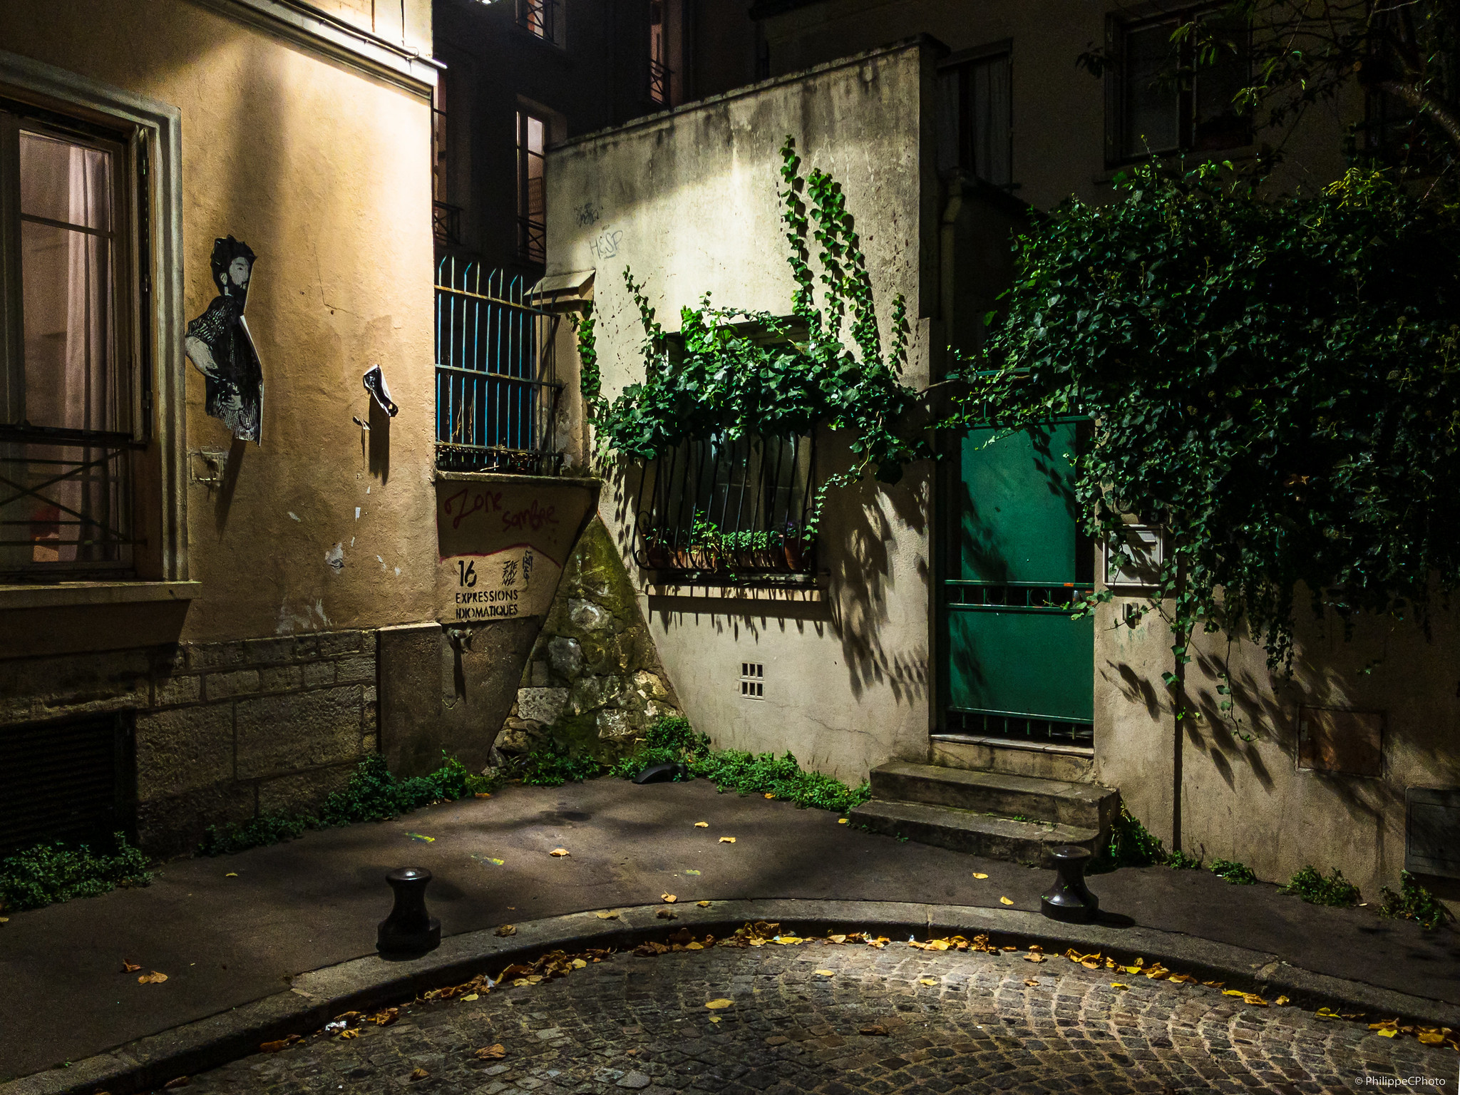
There’s no such thing as a correct exposure.
The right exposure is not an objective thruth, it’s a matter of opinion.
Use exposure to create the feelings that you want.
CHIAROSCURO — The Dynamic Range Mistake Jamie Windsor

Slide 3
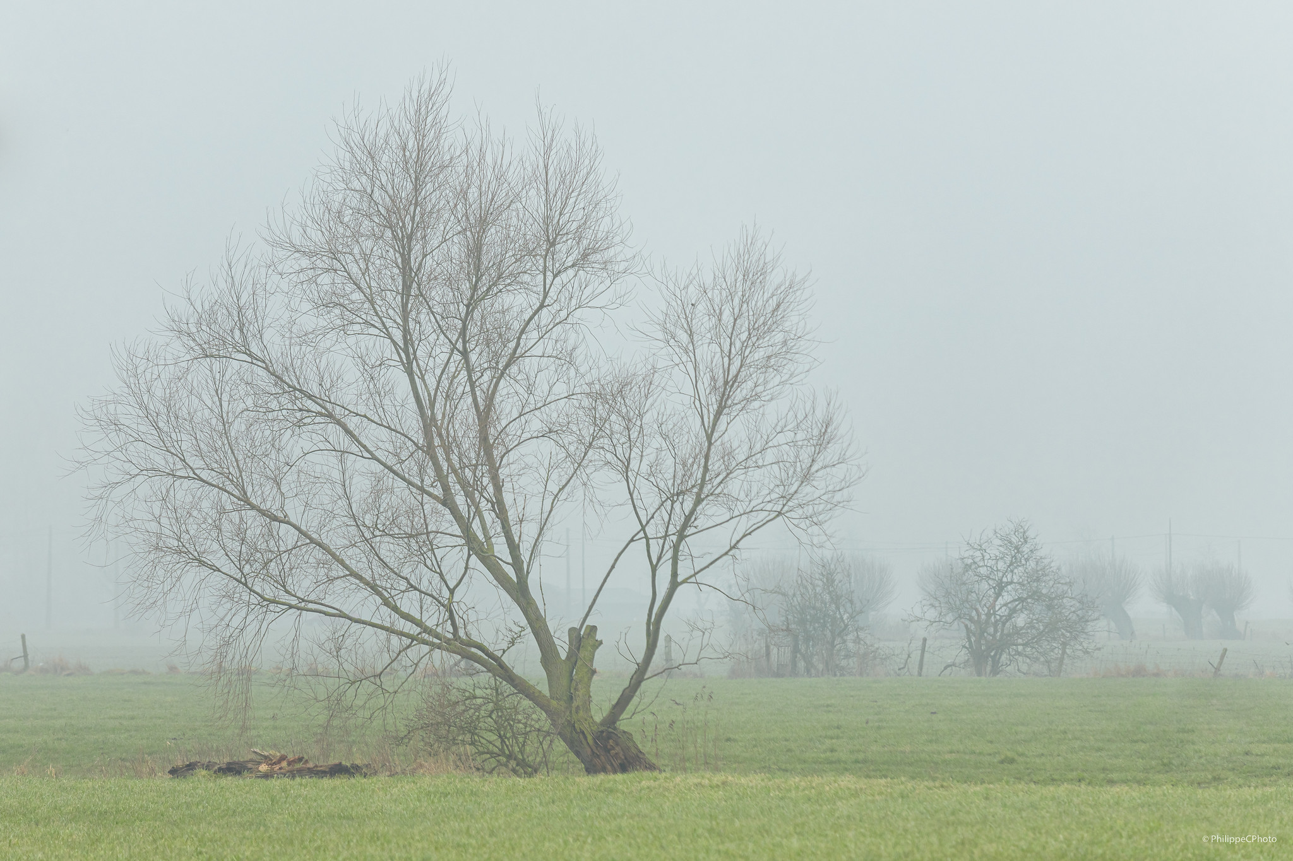

Slide 4
Dynamic Range

Slide 5
Dynamic range is the ratio between the largest and smallest values that a certain quantity can assume. It is often used in the context of signals, like sound and light. It is measured either as a ratio or as a base-10 (decibel) or base-2 (doublings, bits or stops) logarithmic value of the difference between the smallest and largest signal values.
Dynamic range is the range from brightest to darkest visible area of an image. The human eye can see brighter and darker areas than can be captured on a sensor, but the more dynamic range a sensor is capable of capturing, the greater the range that will be represented in the image. Sensors with more dynamic range provide greater latitude for shadow and highlight recovery. A dynamic range of 10 Stops / EV means that the device is able to record or reproduce light with a ratio of 1/1.000.
The ratio for a printed image is around 1/100.

Slide 6
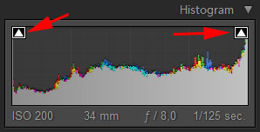
If you’ve ever had to take a photograph on a bright sunny day, chances are pretty high that you would have lost detail, possibly in the shadows or in the highlights, perhaps even both. This is not an exposure problem on your part, it’s more likely a limitation of the dynamic range of your camera – almost all cameras will come up against this problem at some time.

Slide 8
CONTRAST

Slide 9
Contrast means difference. In photography, the most common differences are achieved by changes in the tones or colors that compose the image. It is the degree of difference between the elements that form an image.
TONAL : Difference between high and low lights
COLOUR : Difference between colours – See colour wheels
CONCEPTUAL : Difference in the concept

Slide 10
Contrast means difference. In photography, the most common differences are achieved by changes in the tones or colors that compose the image. It is the degree of difference between the elements that form an image.
TONAL : Difference between high and low lights
COLOUR : Difference between colours – See colour wheels
CONCEPTUAL : Difference in the concept

Slide 11
Low Contrast
High Contrast

Slide 12
To make (again) a long story short
The contrast is the capability to make a difference between the elements of a picture.
The contrast is the capability to make a difference between the elements of a picture.
To make (again) a long story short

Slide 13
The ZONE SYSTEM

Slide 14
Every landscape photographer has heard about Ansel Adams. The famous American is mostly known for his black and white photos of Yosemite National Park.
One of the reasons why Adams is seen as a great photographer is because of his famous zone-system. With this system Adams was able to perfectly control the contrast in his black and white photos. Adams base rule was: “Expose for the shadows; develop for the highlights.”

Slide 15
Don’t miss the companion article about “High Dynamic range” in the April 2021 edition of the Viewfinders Newsletter.

Slide 16
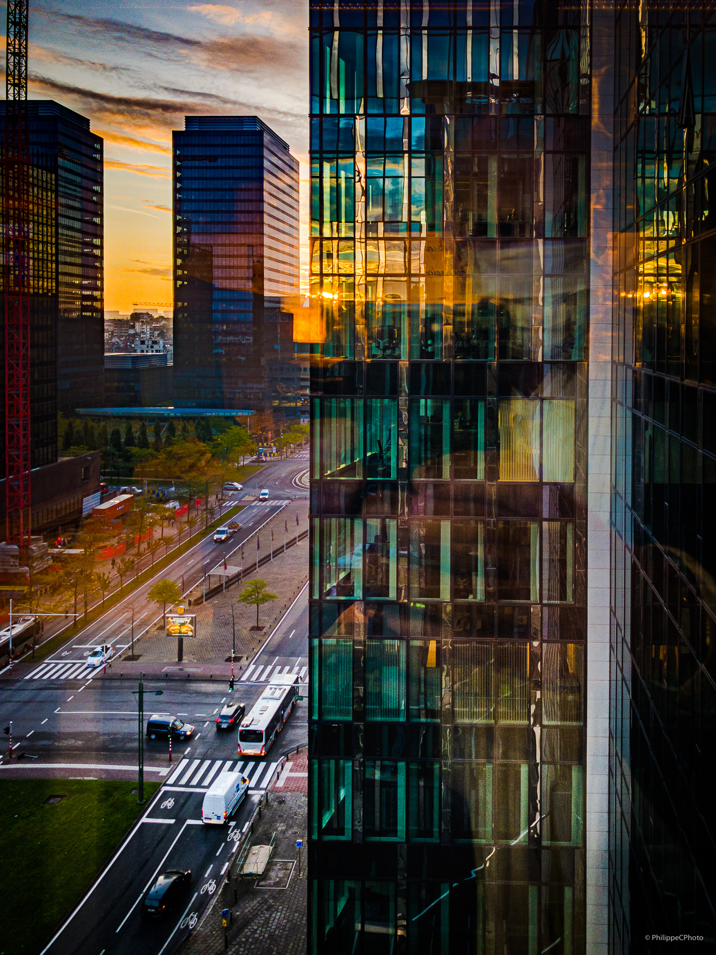
Sources
CHIAROSCURO — The Dynamic Range Mistake
Wikipedia Dynamic Range
Dynamic Range Photography Explained
DynamicRange and Contrast in Photography
All about Contrast
How to Use the Ansel Adams Zone System in the Digital World
Deep Dive
Diving into Dynamic Range

Slide 17
Follow Me on
Instagram philippecphoto
Facebook PhilippeCPhotographie
Web photos.philippec.be
Flickr philippephotos

Slide 18
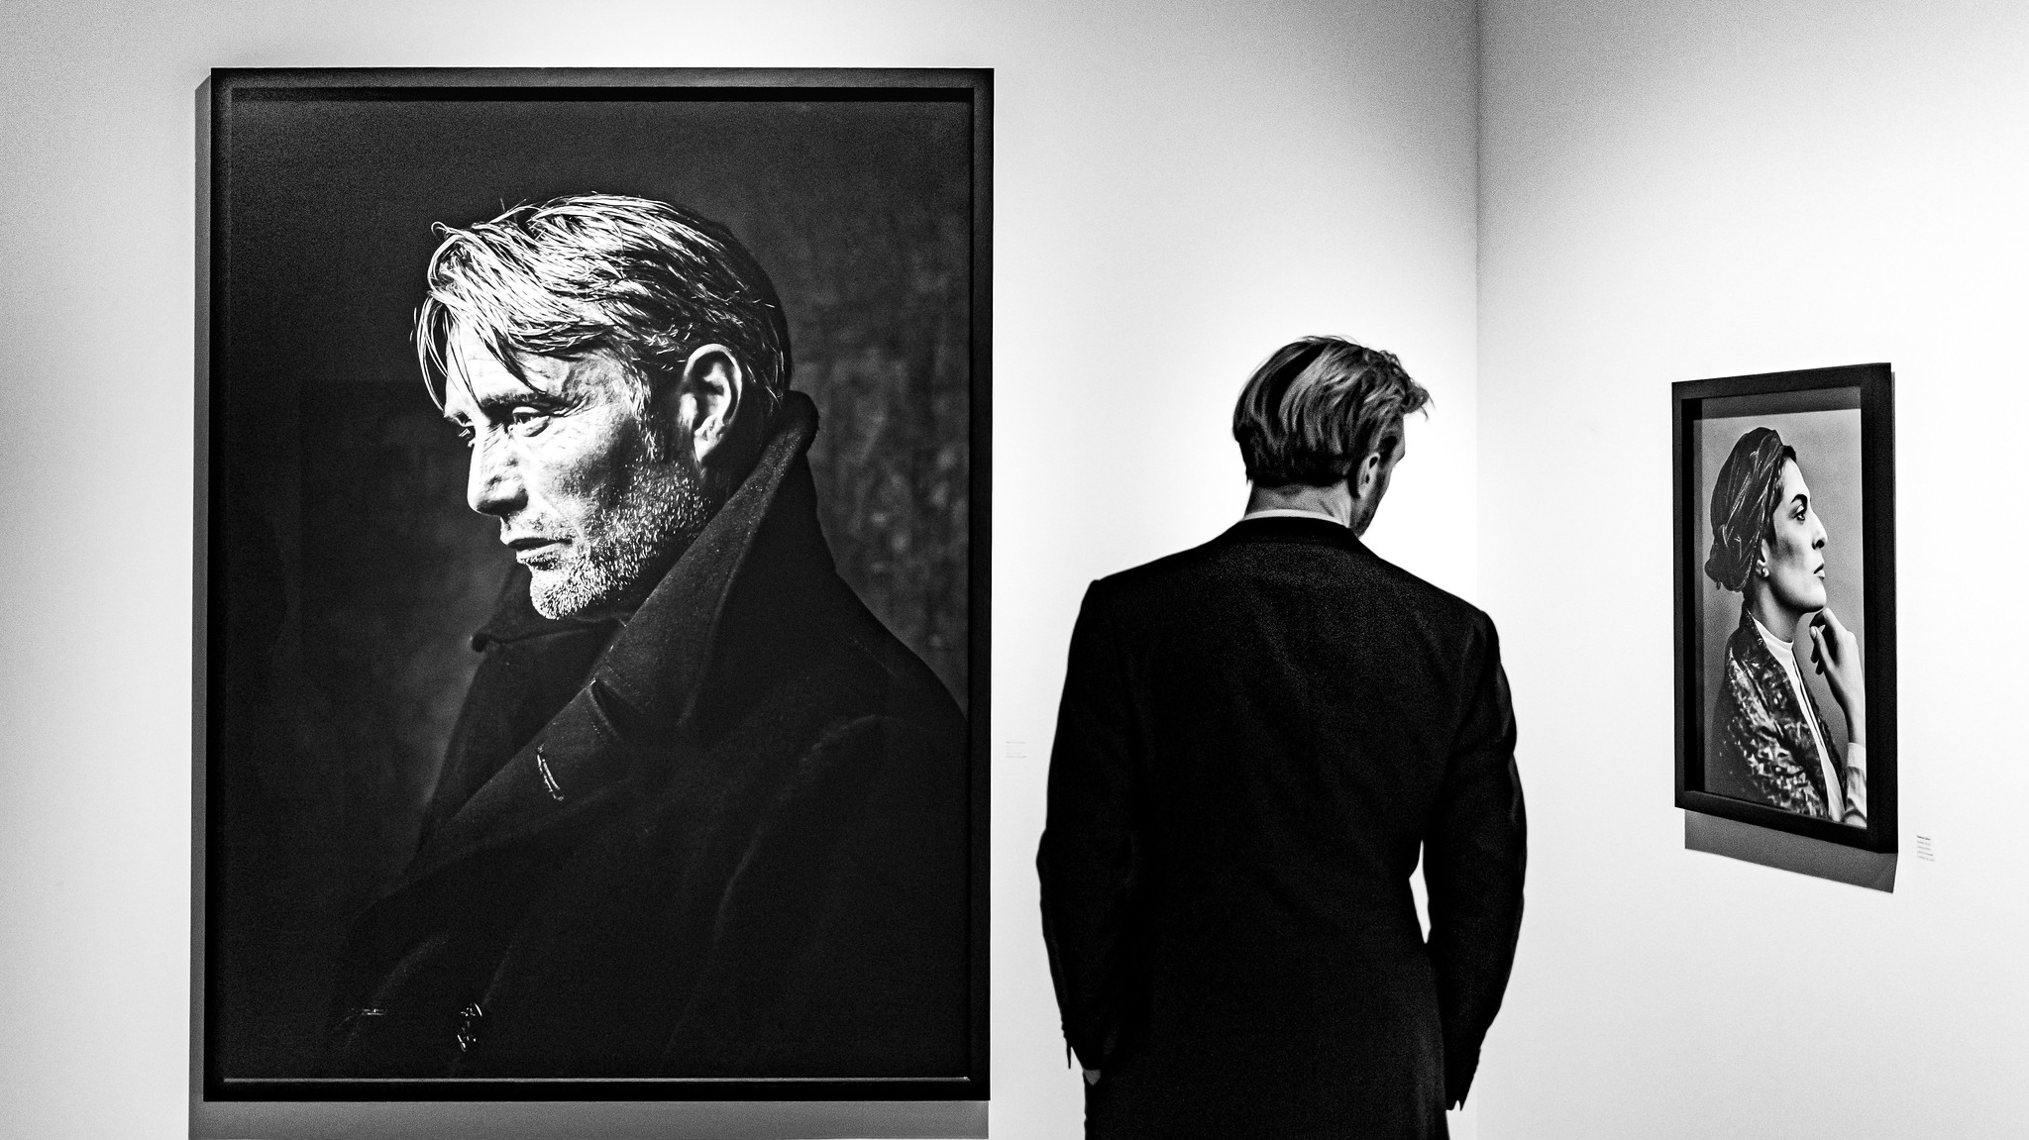
Thank You !

